Slide 1
Image Caption Generation with Deep Learning
Team ID : C28
N. Abhiram 1602-20-737-121
S. Sai Venkatesh 1602-20-737-314
Guide: Dr. Kezia Rani
Assistant Professor, Internal Guide

Slide 2
Problem Statement
The Project seeks to develop an image captioning model using Neural Network Comprising CNN and LSTM layers .The objective is to generate meaningful captions for input images, effectively connecting visual and textual information to produce coherent, contextually appropriate descriptions.

Slide 3
Abstract
This project improves image captioning by combining object detection with traditional methods. It uses pre-trained models for image features and attention mechanisms to focus on important parts, resulting in more accurate and descriptive captions.

Slide 4
Literature Survey
Author : C.S.Kanimozhiselvi Professor, Department of Information Technology, Kongu Engineering College, Erode, Tamilnadu, India.
Journal : IMAGE CAPTIONING USING DEEP LEARNING
YEAR OF PUBLICATION : 2022

Slide 5
Preprocessing of Dataset.
Feature Extraction
  Inception-v3 , ResNet50 and Xception
Caption Generation
  LSTM
The Inception-V3,Xception and ResNet50 with LSTM have shown lesser accuracies so we are using a recently developed algorithm known as VGG16 with LSTM to improve the accuracy.

Slide 6
Proposed Methodology
How this works?
Feature extraction(VGG16)
Train a captioning model
Generate a caption through model(LSTM)

Slide 7
Objective
Methodology:
Feature Extraction : VGG16
Caption Generation : LSTM
Goals:
Content Understanding
Generating Descriptive Captions

Slide 8
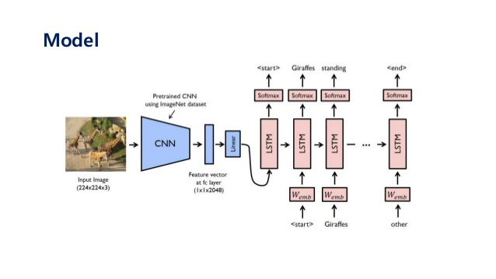

Slide 9
VGG16
CNN architecture for image classification with 3x3 filters and consistent layers
VGG16 takes input tensor size as 224, 244 with 3 RGB channel
Consistent 3*3 filters, stride 1, same padding and 2*2 max pool
Conv layers: 64, 128, 256, 512 filters in Conv-1 to Conv-5.
Consistent arrangement of convolution and max pool layers

Slide 10
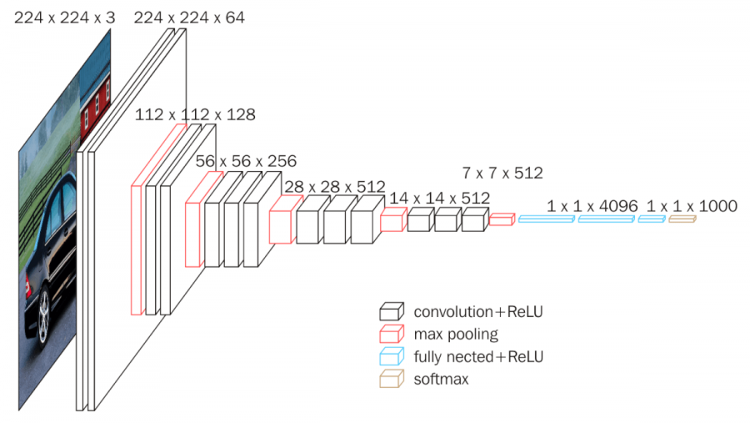

Slide 11
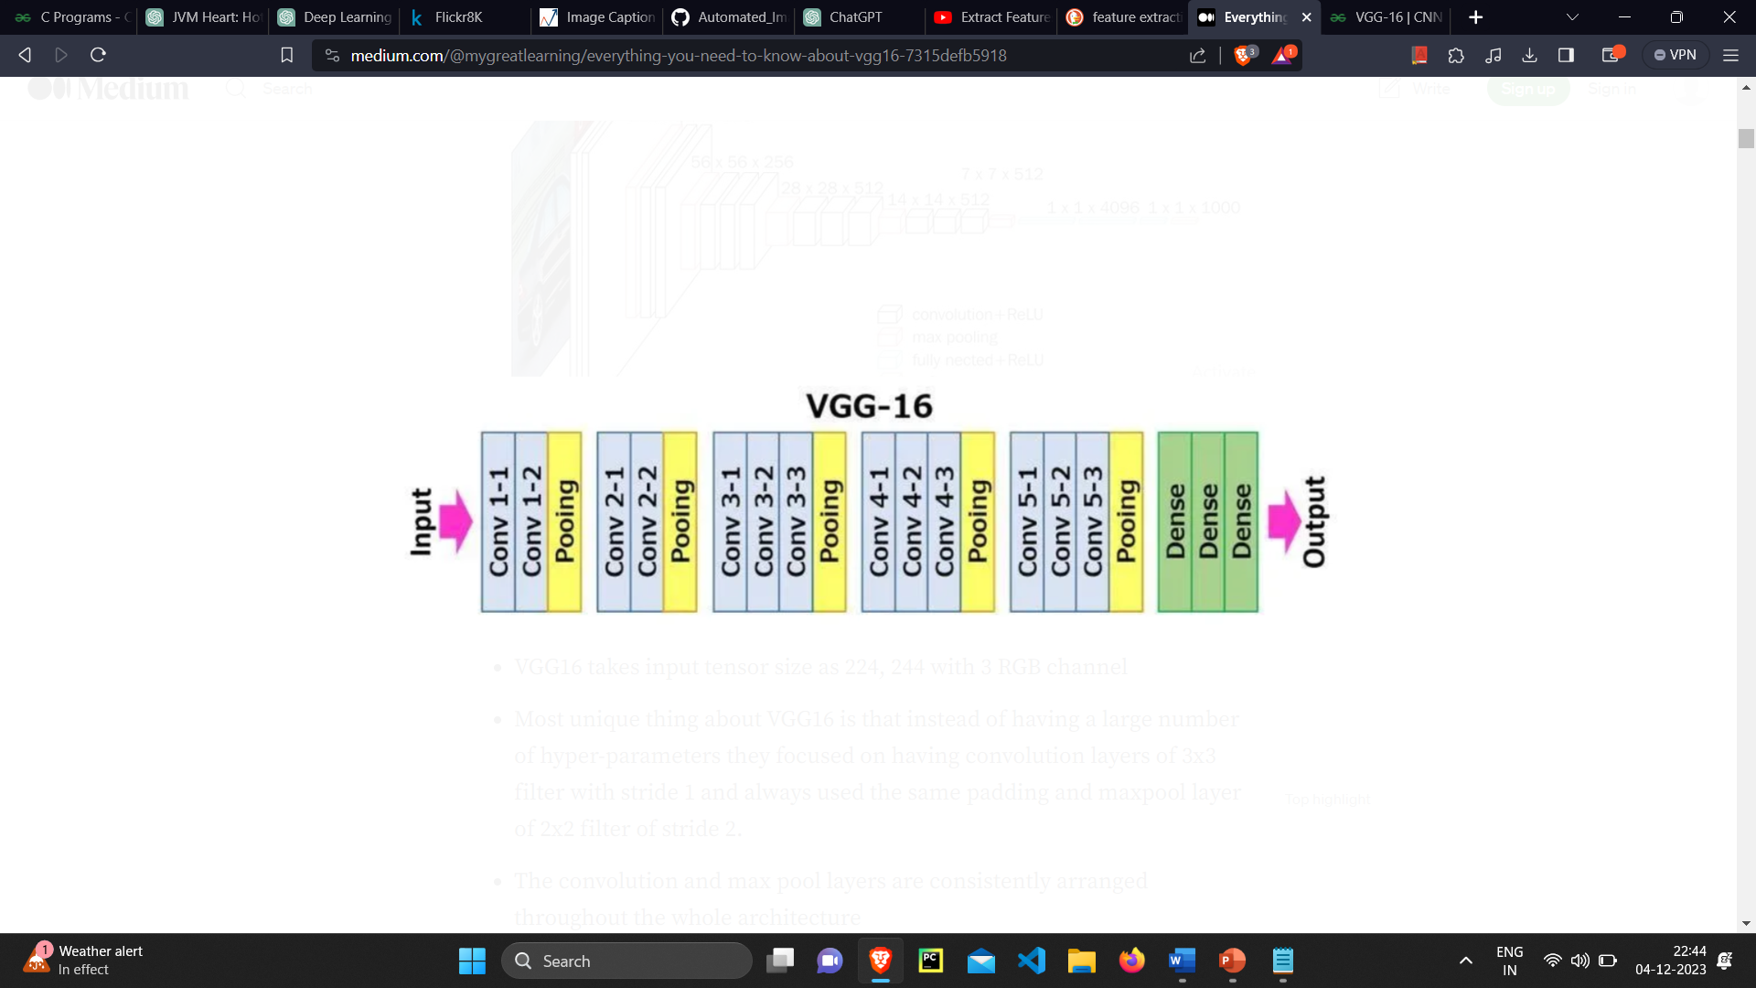

Slide 12
LSTM
Object Recognition.
Grammar Structure.
Combining Image Features with Text.
To train an LSTM for image captioning we can use publicly available datasets that include images and their corresponding captions.
Ex: Flickr8k,MS COCO etc.

Slide 13
Dataset
https://www.kaggle.com/datasets/dibyansudiptiman/flickr-8k
https://www.kaggle.com/datasets/adityajn105/flickr8k
https://www.kaggle.com/datasets/hsankesara/flickr-image-dataset

Slide 14
Future Scope
Assistance for Visually Impaired
Creative and Emotional Captions

Slide 15
Conclusion
The integration of VGG16 for feature extraction and Long Short-Term Memory (LSTM) networks for caption generation presents a promising approach to image captioning through deep learning. While the practical implementation is yet to be undertaken, the theoretical foundation and existing literature suggest several potential advantages to this methodology.

Slide 16
References
C. S. Kanimozhiselvi, K. V, K. S. P and K. S, "Image Captioning Using Deep Learning," 2022 International Conference on Computer Communication and Informatics (ICCCI), Coimbatore, India, 2022.
https://www.geeksforgeeks.org/vgg-16-cnn-model/

Slide 17
THANK YOU

